Slide 1
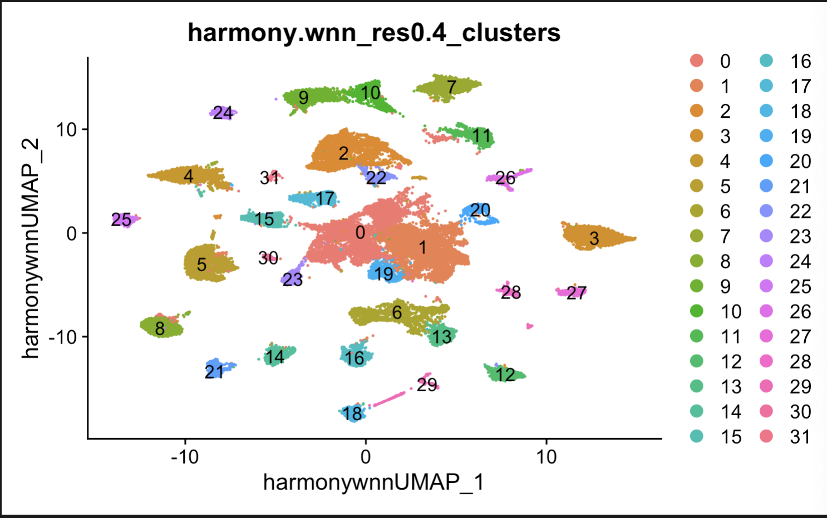
Old multiome object

Slide 2
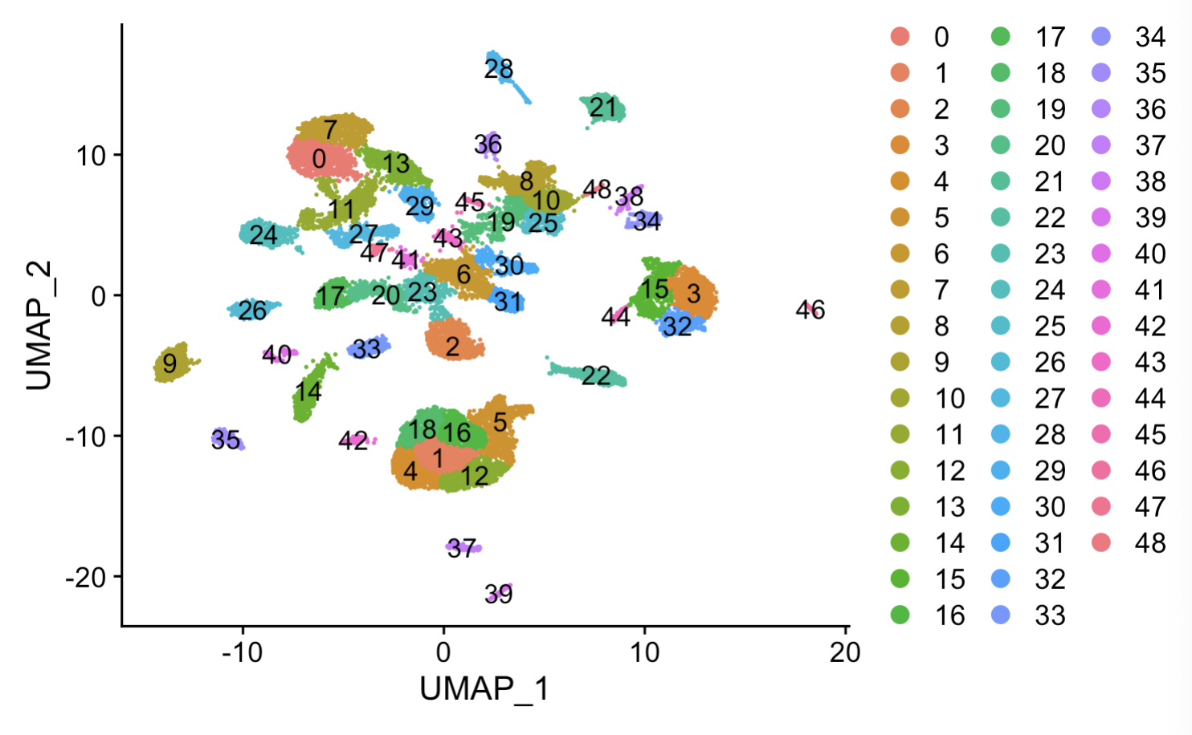
Old tel object (child)

Slide 3
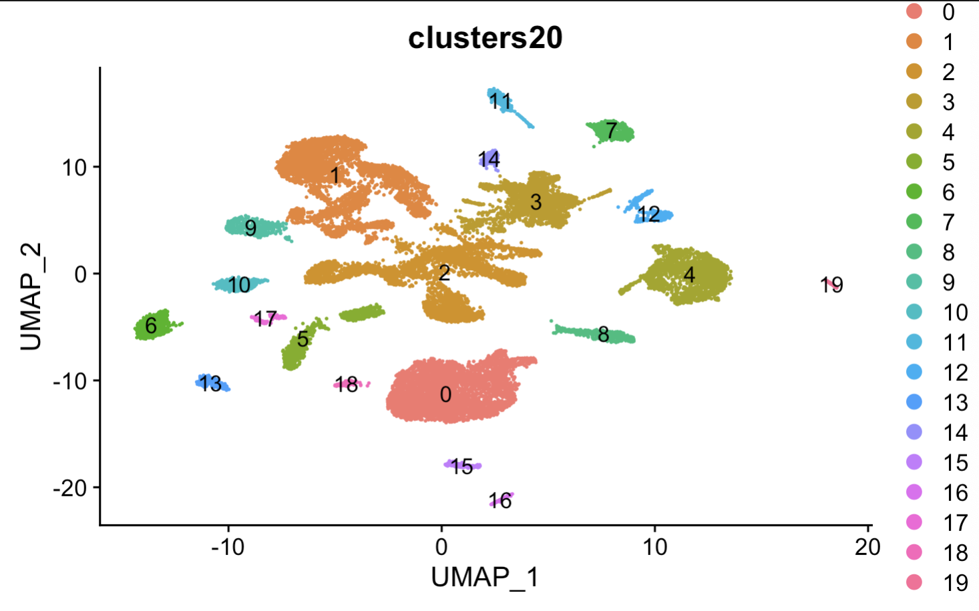
Old tel object (parent)

Slide 4
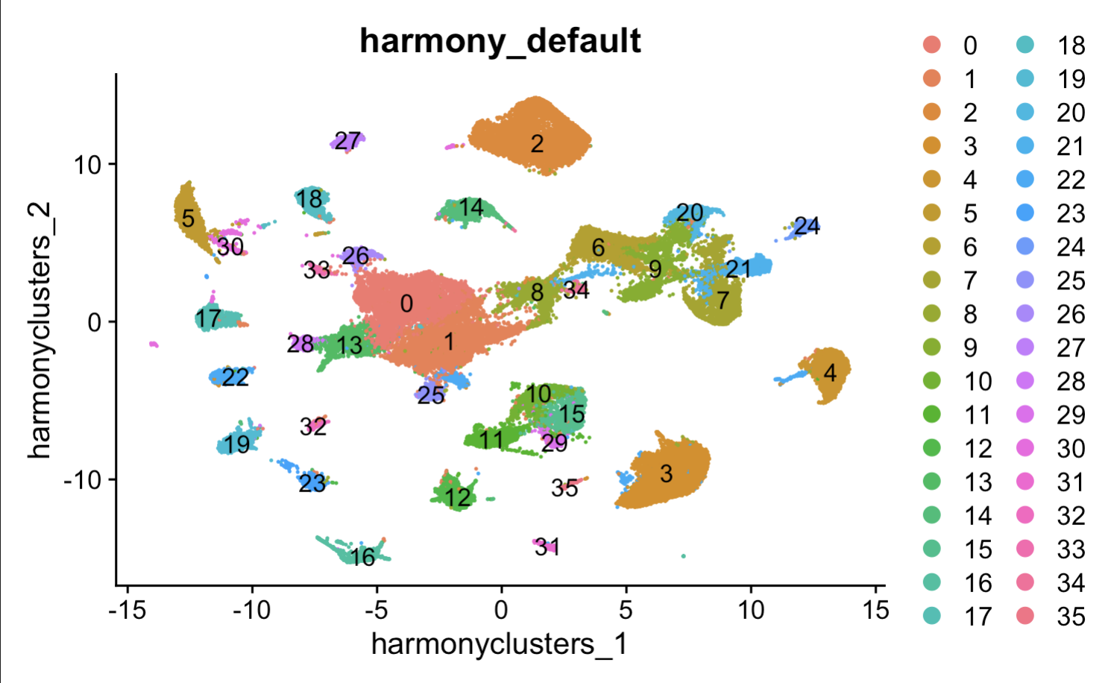
Integrated – default clustering

Slide 5
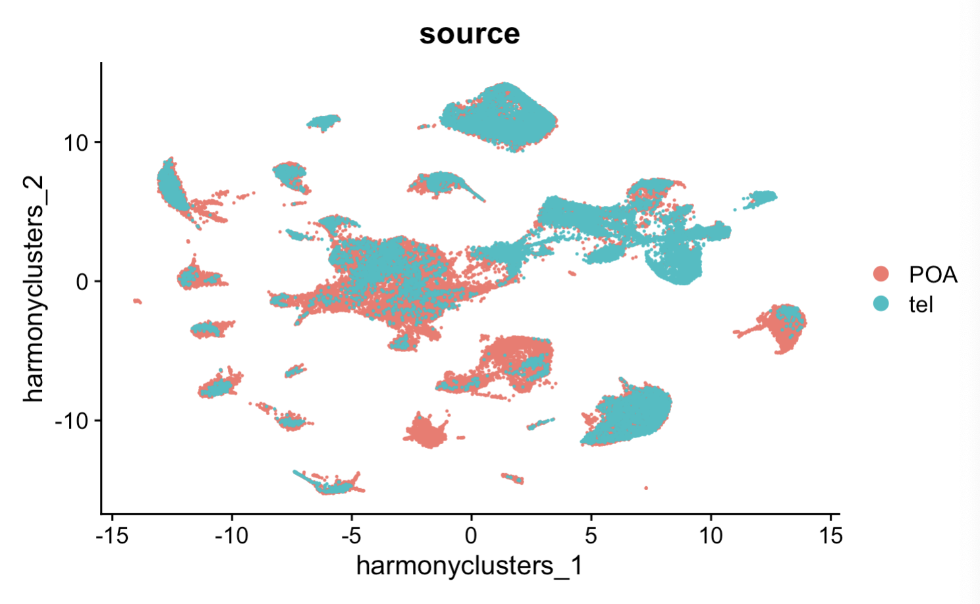
By source

Slide 6
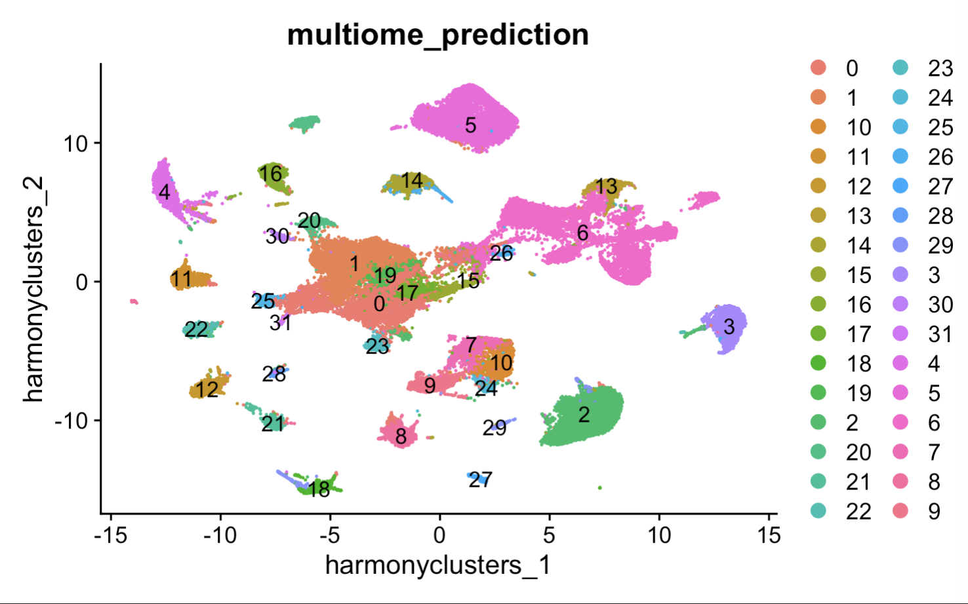
Old multiome labels projected onto integrated object

Slide 7
Removed clusters
What I labeled these clusters in my thesis, I believe per our emails using CV, these are all the ones we removed
Removed = c(
3,#GLUT_gal+/fat2+
5, #GABA_npy+/ndst3+
6, #GLUT_Dm
7,#GLUT_tac1+/kcnip4a+
8, #GLUT_POA_3
13, #GLUT_cckb+/rftn1a+
15,
17, #GLUT_POA_4
29,#Pericyte
30#GABA_th2+/cart2+
)

Slide 8
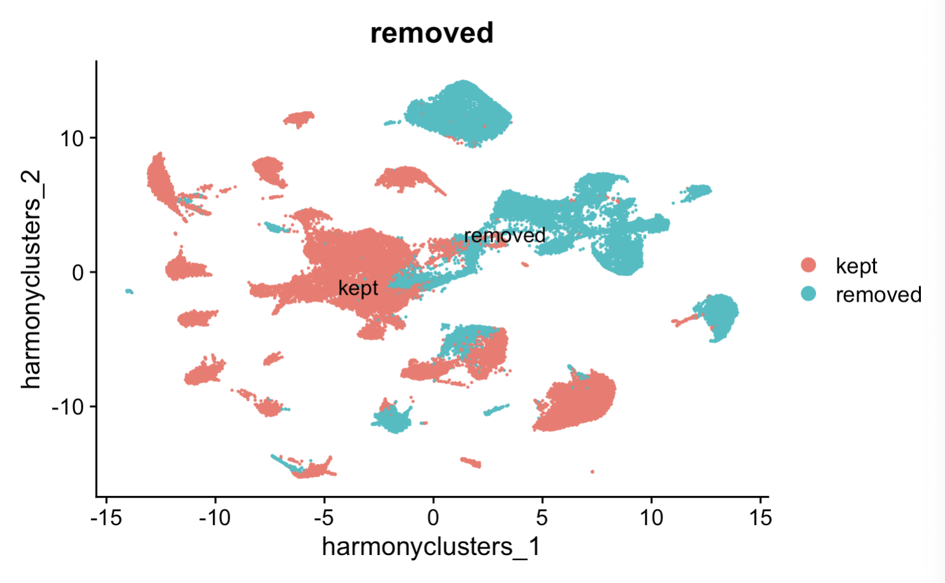
Labeling removed clusters

Slide 9
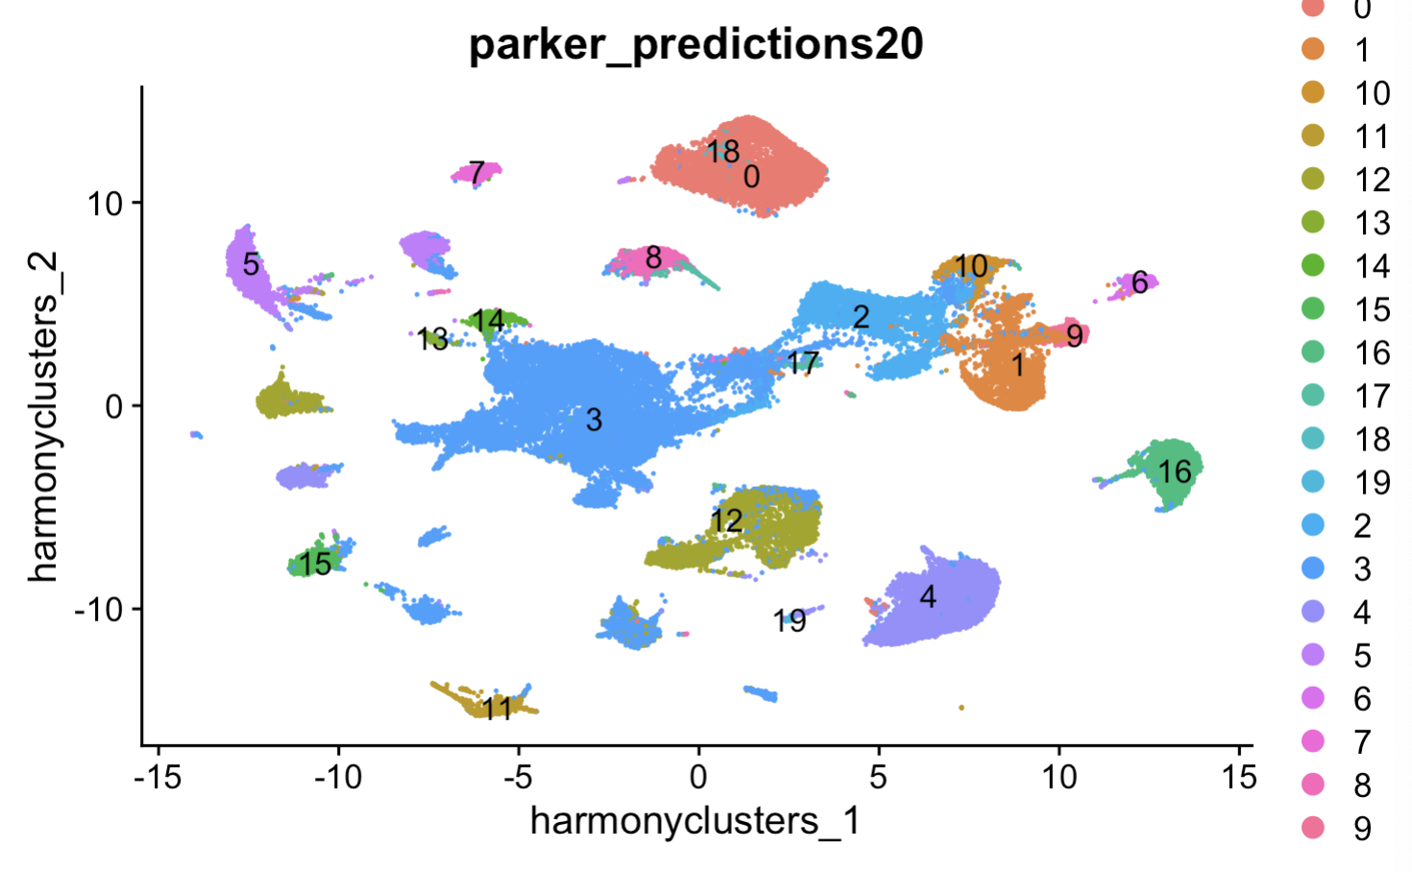
Tel parent clusters projected on integrated object

Slide 10
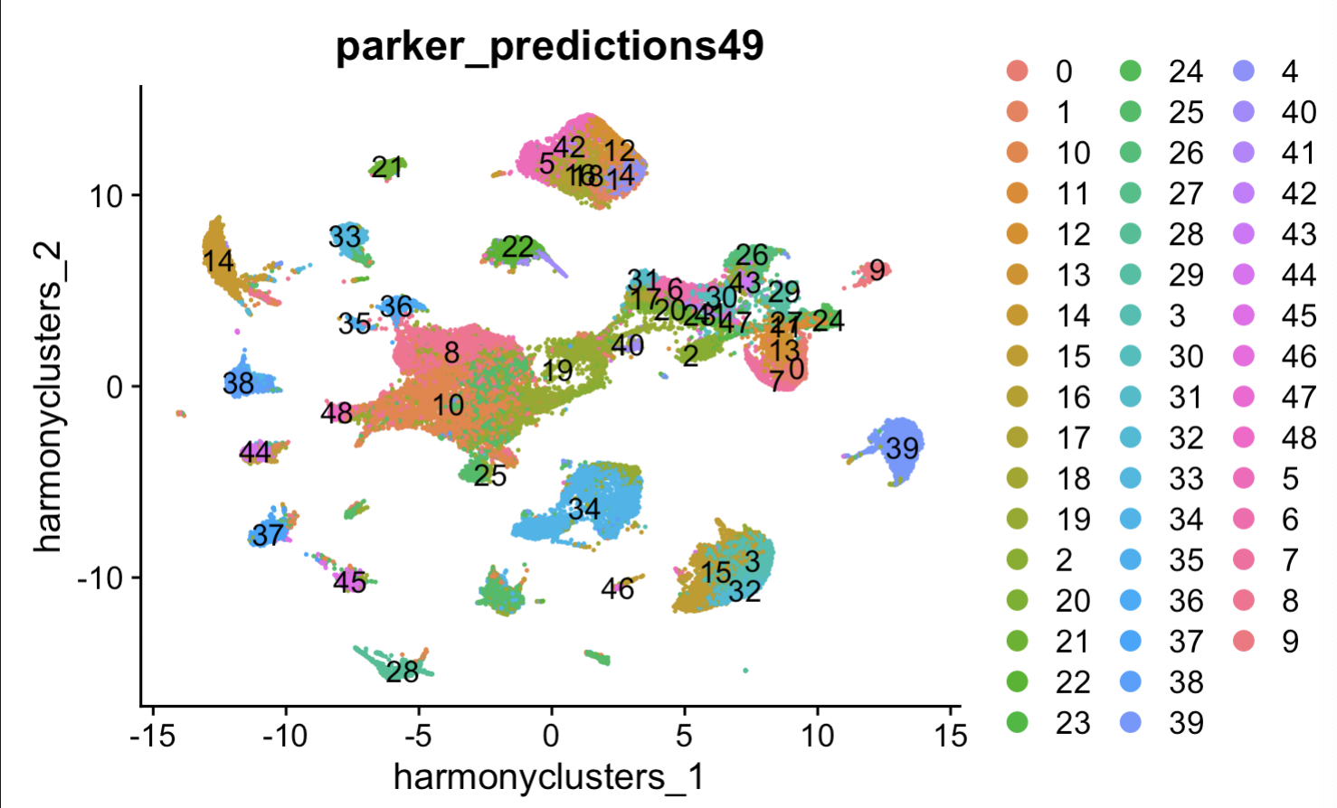
Tel child clusters projected on integrated object

